Slide 1
Tutorial on Human-Centred Explainable AI (HCXAI) Principles, Guidelines, and Practical Examples
The 22nd Australasian Data Science and Machine Learning Conference (AusDM’24) | Melbourne, Australia | 25-27 November 2024
Dr Ronal Singh
Research Scientist
Human-Centric Security & CINTEL FSP,
CSIRO's Data61
Prof Tim Miller
Professor of AI
School of Electrical Engineering and Computer Science
The University of Queensland

Slide 2
How would audience ask questions: During the tutorial Follow up (afterwards??) Tutorial Materials Link

Slide 3
Agenda
Item | Description | Time (mins)
Introduction | Welcome and Objectives. Overview of XAI and HCXAI | 20
Taxonomy of Explanation Types | Taxonomy of Explanation Types: Explain local vs. global, model-agnostic vs. model-specific explanations, feature-based, example-based, and counterfactual explanations. | 30
Overview of HCXAI | Key HCXAI principles and concepts, such as understanding, trust, and usability. | 30
BREAK |  | 20
Designing for User Engagement and Control | Techniques to improve engagement, control and enhance decision-making | 30
User Studies in XAI | Designing and Conducting User Studies: Overview of user-cantered design and evaluation metrics in HCXAI, focusing measure such as understanding, trust, and task performance. | 30
Conclusion and Q&A | Summary of Key Concepts and Q&A | 20

Slide 4

Why are you interested in Explainable AI (XAI)? Why are you interested in Human-Centered XAI?

Slide 5
Part 1: Welcome and Overview

Slide 6
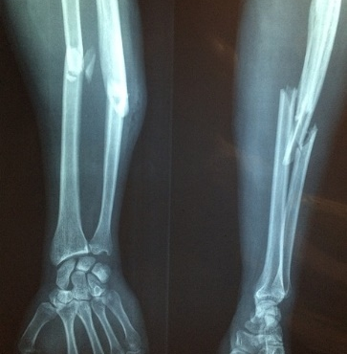





AI/ML applied in many domains, including healthcare, law, cybersecurity
Notes:
PICTURES!!

Slide 7





AI/ML applied in many domains, including healthcare, law, cybersecurity
Prediction = Fracture
Predictive Model
Radiologist
Prediction = Benign
Predictive Model
Security Operations Centre Analysts

Slide 8



WHAT IS EXPLAINABLE AI?
Explainable AI =
understanding AI models and decisions
Explanation answers a
why question
Notes:
This is philosophy, cognitive psychology/science, and social psychology.

Slide 9
Interpretability vs explainability vs transparency?
Add a discussion on “thoughts” on the differences….

Slide 10
What is Explainable AI?
Prediction = Fracture
Predictive Model
Radiologist
XAI: Explaining model decisions
Prediction = Benign
Predictive Model
Security Operations Centre Analysts

Slide 11


WHO CARES ABOUT EXPLAINABLE AI? WHY? WHEN?
Who is asking?
Prediction = Fracture
Predictive Model
Why is the user asking the specific question?

Slide 12






WHO CARES ABOUT EXPLAINABLE AI? WHY? WHEN?
How does a model work?
What is driving decisions?
Can I trust the model?
Data Scientist
Business Owner
Risk Modeller
Regulator
Consumer
Understand the
model
Understand the
model
Challenge the
model
Check impact of model on consumers
“What is the impact on me?”
Debug the model
Evaluate model
suitability
Ensure model
robustness
Improve model
performance
Verify model reliability
“What actions can I take?”
Accept model use
Approve model
Source: V. Belle and I. Papantonis: Principles and practice of explainable machine learning, arXiv, 2020. https://arxiv.org/abs/2009.11698
Notes:
This links mostly to:
Improved decision making: better and/or faster decisions and TRUST
Improved ethical systems: unreasonable to make decisions about people without reasons; sometimes unreasonable to hold someone *accountable* when using an algorithm to provide a decision aid when that algorithm gets it wrong.

Slide 13
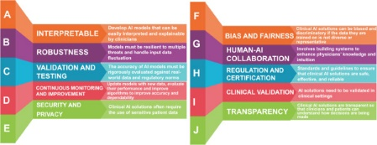



Do I understand how does the model work?
XAI enables a model to be understood by a human
Understanding could lead to (refine this):
Better, fair and ethical decision-making
New knowledge or perspective

Slide 14
Goals of this tutorial
What is Human-Centered Explainable AI (HCXAI), and how does it differ from and complement traditional XAI approaches?
What are different explanation methods (e.g., feature-based, example-based) available to us?
How to design explanations that potentially prevent over-reliance or under-reliance on AI, and what techniques promote user engagement and control?
What are essential considerations and metrics for evaluating XAI systems?

Slide 15
Part 2: Taxonomy of Explanation Types

Slide 16
MODEL-AGNOSTIC VS. MODEL-SPECIFIC
MODEL SPECIFIC
Input
Inner workings of model used for XAI
Model
MODEL AGNOSTIC
Uses only inputs and outputs for XAI
Output
Explain
Applicable to any model with that interface
Notes:
Model agnostic is more ‘useful’ but cannot take advantage of things known about the model

Slide 17
MODEL-AGNOSTIC VS. MODEL-SPECIFIC
MODEL SPECIFIC
Input
Inner workings of model used for XAI
Model
XAI
MODEL AGNOSTIC
Uses only inputs and outputs for XAI
Output
Explain
Applicable to any model with that interface
Notes:
Model agnostic is more ‘useful’ but cannot take advantage of things known about the model

Slide 18
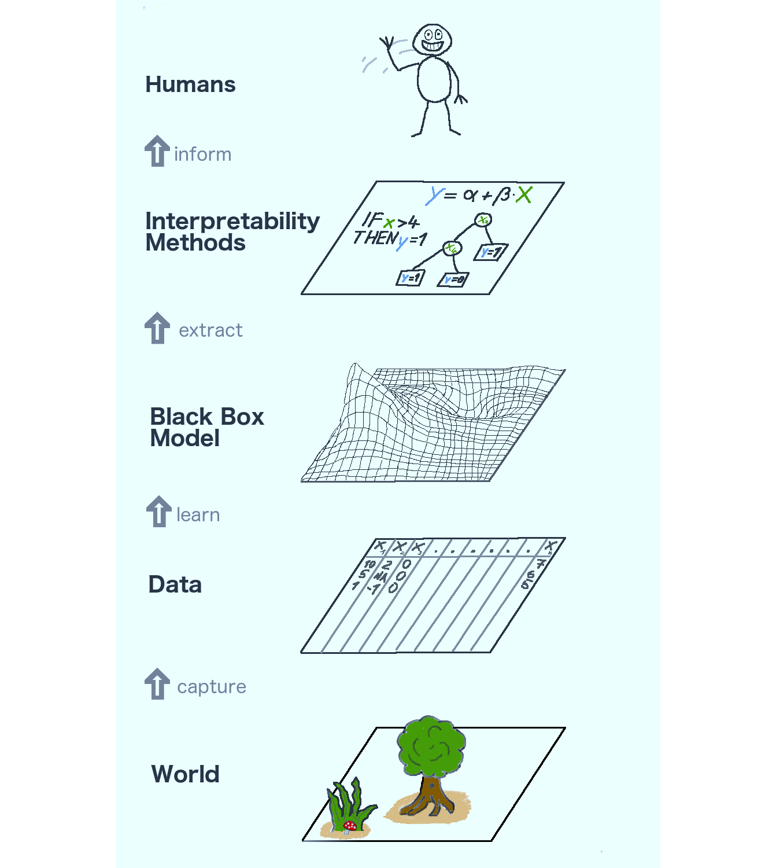
INTRINSIC VS. POST-HOC
No. wings = 2
true
false
No. eyes ≤ 4
No. legs ≥ 8
true
false
true
false
vs.
Mozzie
Stinger?
Spider
Beetle
true
false
Bee
Fly

Slide 19
FOUNDATIONAL METHODS IN EXPLAINABLE AI

Slide 20

Exercise
Suppose you applied for a job via a company’s job application portal. A few hours after your application, you get an email that says that your application was analysed by an automated system that decided not to offer you an interview.
What would you want the explanation to comprise?
What would make it a good explanation for you?
Notes:
What’s the point?
More about decision rationale
Why should “we” decide? Then who should decide?

Slide 21
Available Tools (refine)
Alibi (SeldonIO):
Alibi is a Python library for machine learning model interpretability and explanation.
Offers methods for instance-based explanations, such as counterfactuals and anchors
Captum (PyTorch):
Captum is an open-source, model interpretability library built on PyTorch.
DALEX (ModelOriented):
DALEX is a model-agnostic explainability package designed for both R and Python.
AI Explainability 360 (AIX360) (Trusted-AI):
AIX360 is an open-source toolkit developed by IBM for explainability across a wide range of models.
It provides both interpretable models (like rule-based models) and post-hoc explanations for black-box models
InterpretML (interpretml):
InterpretML is a Microsoft-developed, model-agnostic interpretability framework focused on machine learning transparency.
It offers a combination of glass-box (interpretable-by-design) and black-box (post-hoc explainability) models

Slide 22

ATTRIBUTION-BASED EXPLANATIONS
Source: T. Miller: "But why?" Understanding explainable artificial intelligence. XRDS 25, 3 (Spring 2019), 20–25. https://doi.org/10.1145/3313107

Slide 23
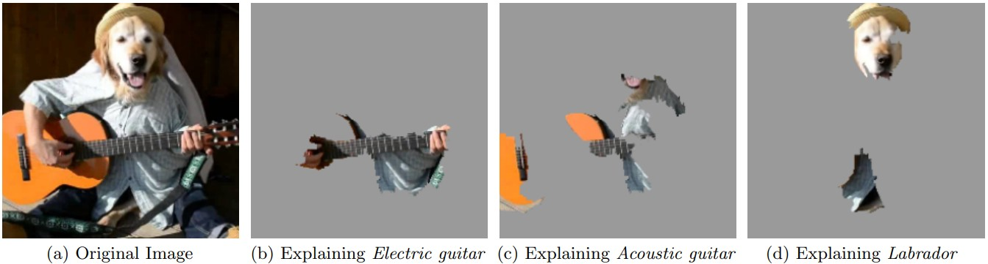
ATTRIBUTION-BASED EXPLANATIONS
Source: Ribeiro et al.: Why should I trust you?: Explaining the predictions of any classifier. In SIGKDD international conference on knowledge discovery and data mining. ACM, 2016.

Slide 24
ATTRIBUTION-BASED EXPLANATIONS (add examples from intrusion detection dataset)
LIME
SHAP

Slide 25

EXAMPLE-BASED EXPLANATION: PROTOYPES
Counterfactual add example….
Source: Kim et al.: Examples are not enough, learn to criticize! Criticism for interpretability. In NeurIPS. 2016.

Slide 26
RULED-BASED EXPLANATION
if respiratory_illness = Yes
and smoker = Yes
and age >= 50
then lung_cancer
elif risk_lung_cancer = Yes
and blood_pressure >= 0.3 then lung_cancer
elif risk_depression = Yes
and past_depression = Yes
then depression
elif BMI >= 0.3
and insurance = None
and blood_pressure >= 0.2
then depression elif smoker = Yes
and BMI >= 0.2
and age >= 60
then diabetes
elif risk_diabetes = Yes
and BMI >= 0.4
and prob_infections >= 0.2
then diabetes
Else Null
EXTRACT RULES POST-HOC
LEARN INTERPRETABLE RULES DIRECTLY

Slide 27
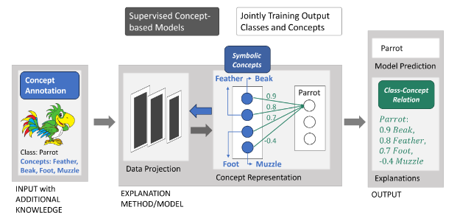
CONCEPT-BASED
Ruihan’s work
Poeta, Eleonora, et al. "Concept-based explainable artificial intelligence: A survey." arXiv preprint arXiv:2312.12936 (2023).

Slide 28
Demos?

Slide 29
Recap
What do you recall about the taxonomy of explanations?
What do you recall about explanation types?

Slide 30
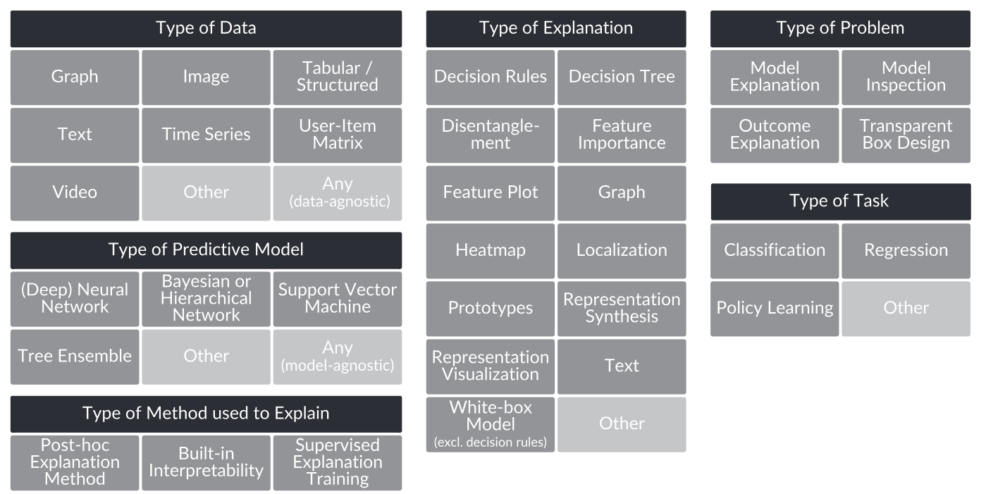
Categorisation of explainable AI methods along six dimensions

Slide 31
Recap
Add notes to summarise main points for audience

Slide 32
Part 3: Towards HCXAI

Slide 33


Suppose you get hired by a Security Operations Centre (SOC) that is interested in applying explainability techniques for the predictive models produced by their platform for detecting intrusion events and supporting SOC analysts in validating these events. That is, you are implementing XAI as part of a decision-support tool. Where would you start? What questions would you ask yourself?
Network flow data
Predictive Model
???
Prediction = malicious
SOC Analysts
Notes:
Focus is on the user

Slide 34
Does these capture what you were think?
Who are your users?
What would they use the XAI for?
What are they trying to achieve by engaging with the model?
What questions would users ask?
How do you collect information about what questions they would ask?
Which XAI techniques would suit the type of questions they are asking?
What types of information does your XAI method and predictive model produce?
Which types of information would you provide them and why?
How do you test the effectiveness of the methods: simulation → user study?
What if I fail? What if I succeed?

Slide 35
Do I understand how does the model work?
XAI enables a model to be understood by a human
Understanding could lead to (refine….):
Better, fair and ethical decision-making
New knowledge or perspective

Slide 36
What is understanding?
What principles if adopted will help design XAI that helps people “understand” the model or its decisions?

Slide 37
Core Principles of XAI
Requirements and needs gathering
Who, What, Why, When, How
XAI:
Incorporate these needs
Content + Adaptability
Controllability
Reduce over-reliance or under-reliance on AI
Calibrated Trust
Evaluation

Slide 38

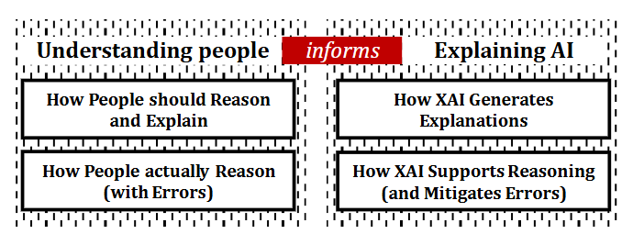
HCXAI Principles: Explanations should align with users reasoning processes
Align explanations with users' reasoning processes
enabling users to generate, test, and revise hypotheses
explanations should actively counter cognitive biases
match explanation types with the purposes based on user needs
align explainability information with users' expectations
co-design with users
Wang, Danding, et al. "Designing theory-driven user-centric explainable AI." Proceedings of the 2019 CHI conference on human factors in computing systems. 2019.

Slide 39
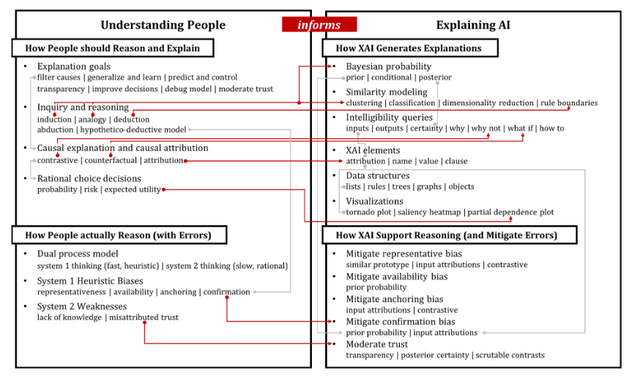
Example
?????

Slide 40
HCXAI Principles: Explanations should align with users’ mental models
build explanations that cater to users' mental models
adapting to both the task at hand and the social context

Slide 41
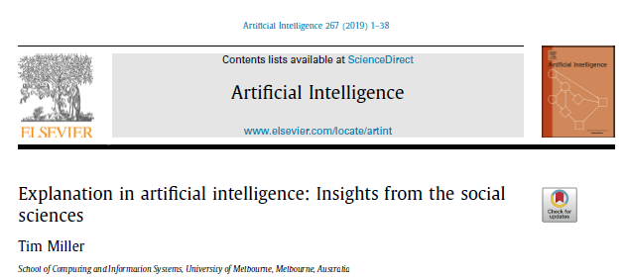
HCXAI: Explanations are contrastive
Explanations are Contrastive
Explanations are Selective
Explanations are Socially Contextualised
moulded by explainer’s and explainee’s beliefs
Miller, Tim. "Explanation in artificial intelligence: Insights from the social sciences." Artificial intelligence 267 (2019): 1-38.

Slide 42
HCXAI Principles: Balancing Transparency and Cognitive Load
minimise cognitive load by focusing only on essential information

Slide 43
HCXAI Principles: Evaluation of Explanations
Technical vs user study
user trust, usability, and task outcomes
both objective and subjective criteria, like perceived usefulness and understandability

Slide 44
Break 20 minutes

Slide 45
Part 4: Designing for User Engagement and Control

Slide 46
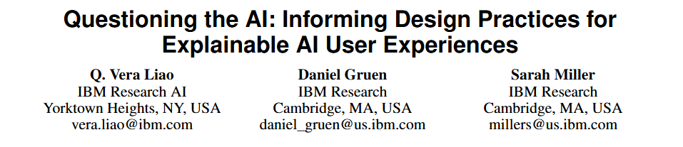
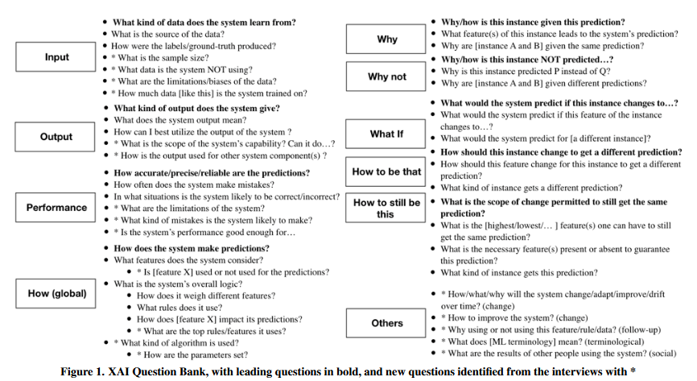
HCXAI: Start by understanding user needs
A question bank representing user needs for explainability, grounded in the types of questions users typically ask.
Effective AI explanations may need to be interactive, evolving in response to user engagement, and adapting to different levels of user understanding.
Liao, Q. Vera, Daniel Gruen, and Sarah Miller. "Questioning the AI: informing design practices for explainable AI user experiences." Proceedings of the 2020 CHI conference on human factors in computing systems. 2020.

Slide 47
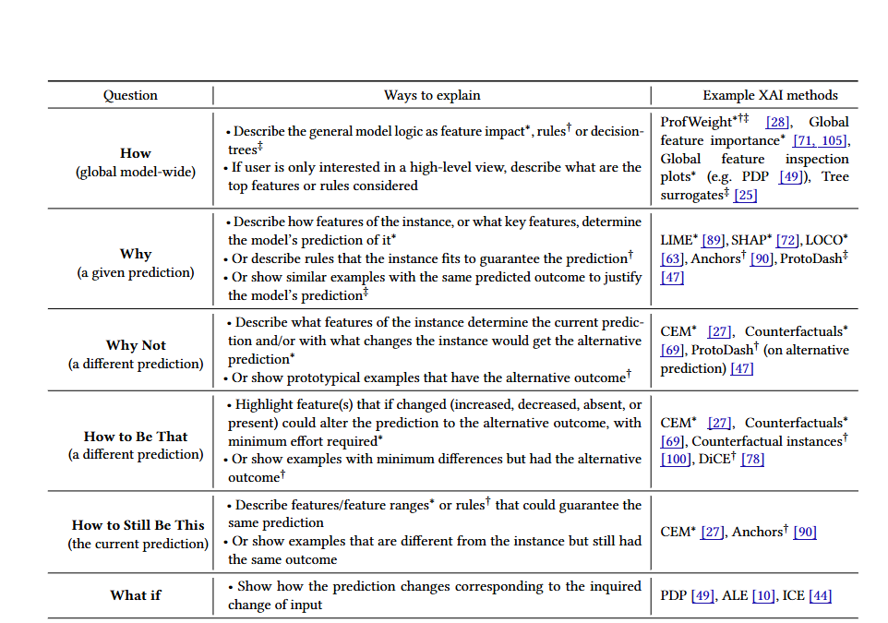
HCXAI: Map user questions to existing methods (iteratively refine through evaluation)
Notes:
What’s the point?
More about decision rationale but could also be about the

Slide 48
HCXAI: Explanations are contrastive
Explanations are Contrastive
Explanations are Selective
Explanations are Socially Contextualised
moulded by explainer’s and explainee’s beliefs
Miller, Tim. "Explanation in artificial intelligence: Insights from the social sciences." Artificial intelligence 267 (2019): 1-38.

Slide 49

CONTRASTIVE EXPLANATIONS
“The key insight is to recognise that one does not explain events per se, but that one explains why the puzzling event occurred in the target cases but not in some counterfactual contrast case”
DENIS HILTON: CONVERSATIONAL PROCESSES AND CAUSAL EXPLANATION, PSYCHOLOGICAL BULLETIN. 107(11):65-81, (1990)

Slide 50
CONTRASTIVE EXPLANATION THE DIFFERENCE CONDITION
Compound Eyes
Type
Legs
Stinger
Eyes
Wings
Spider
8
✘
8
✘
0
WHY IS IT A FLY RATHER THAN A BEETLE?
Beetle
6
✘
2
✔
2
Bee
6
✔
5
✔
4
Fly
6
✘
5
✔
2

Slide 51
CONTRASTIVE EXPLANATION THE DIFFERENCE CONDITION
Compound Eyes
Type
Legs
Stinger
Eyes
Wings
Spider
8
✘
8
✘
0
WHY IS IT A FLY RATHER THAN A BEETLE?
Beetle
6
✘
2
✔
2
Bee
6
✔
5
✔
4
Fly
6
✘
5
✔
2

Slide 52
CONTRASTIVE EXPLANATION THE DIFFERENCE CONDITION
Compound Eyes
Type
Legs
Stinger
Eyes
Wings
Spider
8
✘
8
✘
0
WHY IS IT A FLY RATHER THAN A BEETLE?
Beetle
6
✘
2
✔
2
Bee
6
✔
5
✔
4
Fly
6
✘
5
✔
2

Slide 53
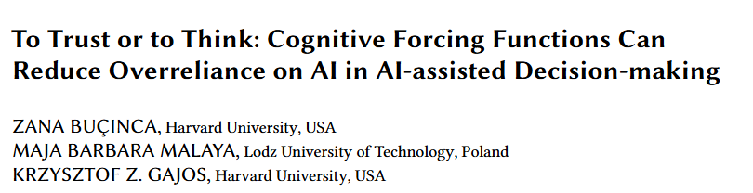
HCXAI: Give control to the users
Cognitive forcing functions → interventions to encourage analytical thinking
CF could potentially reduce overreliance
Need to focus on system usability – user’s may not prefer the best system!
Adaptively apply CF based on task requirements and user characteristics
CF benefits more engaged users!
Buçinca, Zana, Maja Barbara Malaya, and Krzysztof Z. Gajos. "To trust or to think: cognitive forcing functions can reduce overreliance on AI in AI-assisted decision-making." Proceedings of the ACM on Human-computer Interaction 5.CSCW1 (2021): 1-21.

Slide 54
Exercise
Provide explainability approach (info-level) options
Ask users to critique each one

Slide 55
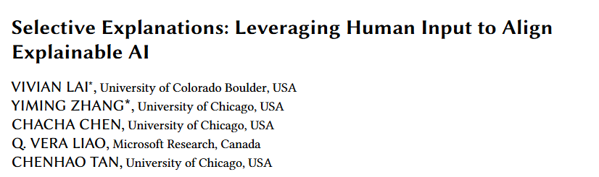
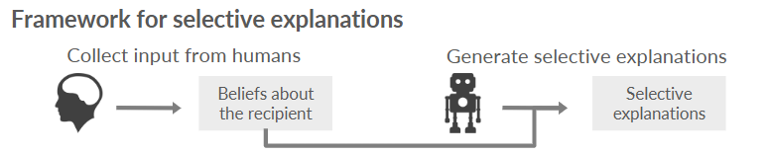
HCXAI: Selectively Presenting Reasoning Based on User’s Preferences.
Focus on relevant information in AI decision-making tasks, reducing cognitive load and preventing over-reliance.
Training supervised learning model of what user’s tag as important
Vivian Lai, Yiming Zhang, Chacha Chen, Q. Vera Liao, and Chenhao Tan. 2023. Selective Explanations: Leveraging Human Input to Align Explainable AI. Proc. ACM Hum.-Comput. Interact. 7, CSCW2, Article 357 (October 2023), 35 pages. https://doi.org/10.1145/3610206

Slide 56
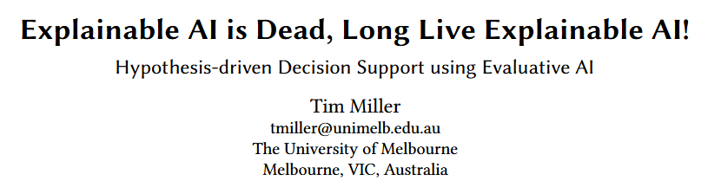
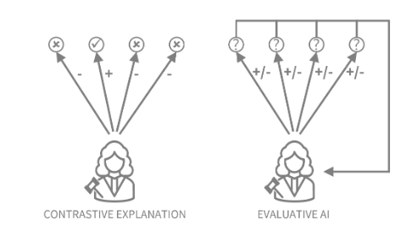
HCXAI: Present evidence for user hypotheses
Encourage a shift from machine-driven to human-centered decision-making
AI aids in judgment rather than making the decision
Highlight evidence and allow users to weigh options
Implement features that facilitate hypothesis testing
Filter out unlikely hypotheses or rank options
Miller, Tim. "Explainable ai is dead, long live explainable ai! hypothesis-driven decision support using evaluative ai." Proceedings of the 2023 ACM conference on fairness, accountability, and transparency. 2023.

Slide 57
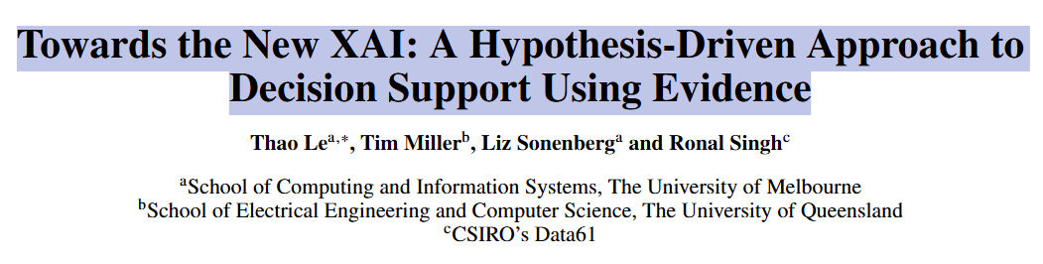
WoE paper (Thao’s work)

Slide 58
Exercise - repeat with EvalAI
Provide explainability approach (info-level) options
Ask users to critique each one

Slide 59
Part 5: Evaluating XAI and User Studies

Slide 60
Add slides and examples on these.
Computational Metrics
Correctness/Faithfulness
Completeness (e.g., coverage of features…)
Consistency
Human Evaluation Metrics
Performance
Understandability (mental model)
Trust
Satisfaction
Other Qualitative feedback
Nauta, Meike, Jan Trienes, Shreyasi Pathak, Elisa Nguyen, Michelle Peters, Yasmin Schmitt, Jörg Schlötterer, Maurice van Keulen, and Christin Seifert. 2023. “From Anecdotal Evidence to Quantitative Evaluation Methods: A Systematic Review on Evaluating Explainable AI.” ACM Computing Surveys 55 (13s): 1–42.
Pawlicki, Marek, Aleksandra Pawlicka, Federica Uccello, Sebastian Szelest, Salvatore D’Antonio, Rafał Kozik, and Michał Choraś. 2024. “Evaluating the Necessity of the Multiple Metrics for Assessing Explainable AI: A Critical Examination.” Neurocomputing 602 (128282): 128282.

Slide 61
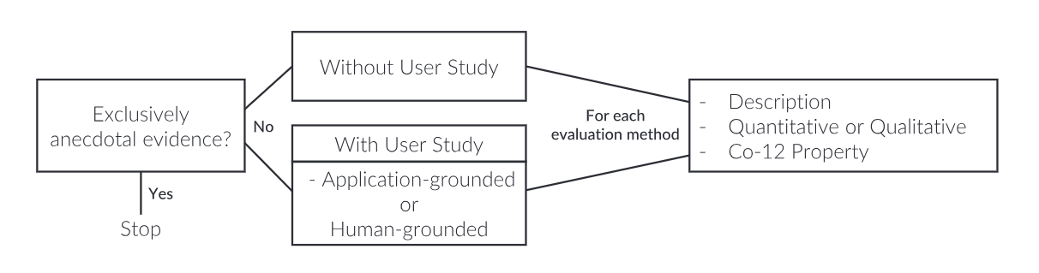

Slide 62
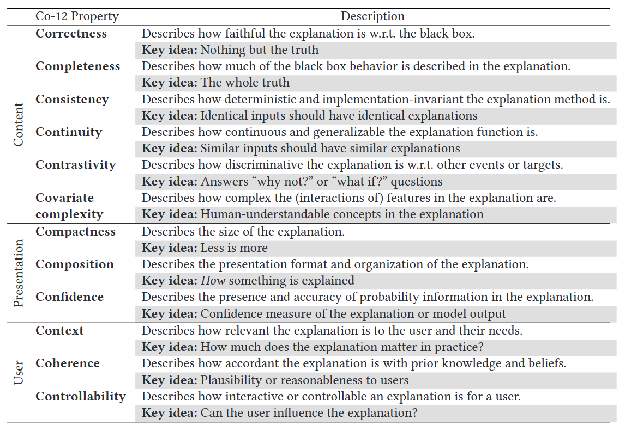

Slide 63
Content Related

Slide 64
Faithfulness
Fidelity : Does explanation reflect model predictions?
Agreement between the output of the predictive model and the explanation when applied to the input, how well the explanations mimic the output of the predictive model if use to make predictions

Slide 65
Faithfulness
Consistency: Identical inputs should have identical explanations
Train a model on synthetic data to be able know what the explanation should look like
Compare the explanation of the model with the ground-truth
Evaluate how closely the explanation reflects the ground truth

Slide 66
Faithfulness
Removal-based evaluation methods: Study the effect of removing/perturbing explanation components and measure the effect on the output
Single component deletion
Incrementally adding
Incrementally deleting

Slide 67
Faithfulness
White box check: use interpretable approaches to derive ground truth explanations
???

Slide 68
Faithfulness
Synthetic Data Check: use interpretable approaches to derive ground truth explanations
Train a model on synthetic data to be able know what the explanation should look like
Compare the explanation of the model with the ground-truth
Evaluate how closely the explanation reflects the ground truth

Slide 69
Presentation Related

Slide 70
Presentation
Compactness
Size of the explanation: e.g., number of features in the explanation, etc

Slide 71
Presentation
Composition
format, organisation and structure of the explanation

Slide 72
User Related

Slide 73
User Related
Context
How much does the explanation matter in practice?

Slide 74
User Related
Coherence
How accordant the explanation is with prior knowledge and beliefs.
Satisfaction

Slide 75
User Related
Controllability
Can the user influence the explanation?

Slide 76
User Related
Trust
Can the user influence the explanation?

Slide 77
User Study Hints
State objectives
RQs
Metrics
Hypotheses
Baselines
Sample Size/ Demographic
Task
appropriate statistical tests
coding interview transcripts
Within-between
Participant type

Slide 78
Examples of User Studies

Slide 79
Part 6: Wrap up and Q&A

Slide 80
Exercise
What information would you provide them to understand?
Network flow data
Predictive Model
???
Prediction = malicious
Security Operations Centre Analysts
Options???
Model,
Prediction,
Model + Prediction
Model + Prediction + XAI, ….
Notes:
What’s the point?
More about decision rationale but could also be about the

Slide 81
Exercise
Which of the following models would you classify as INTRINSIC?
Network flow data
Predictive Model
???
Prediction = malicious
Security Operations Centre Analysts
Notes:
What’s the point?
More about decision rationale but could also be about the

Slide 82
Moving from techno-centric to human-centric XAI
Miller, Tim. 2023. “Explainable AI Is Dead, Long Live Explainable AI! Hypothesis-Driven Decision Support Using Evaluative AI.” In Proceedings of the 2023 ACM Conference on Fairness, Accountability, and Transparency, 333–42. FAccT ’23. New York, NY, USA: Association for Computing Machinery.
Buçinca, Zana, Siddharth Swaroop, Amanda E. Paluch, Finale Doshi-Velez, and Krzysztof Z. Gajos. 2024. “Contrastive Explanations That Anticipate Human Misconceptions Can Improve Human Decision-Making Skills.” arXiv [Cs.HC]. arXiv. http://arxiv.org/abs/2410.04253.
Ma, Shuai. 2024. “Towards Human-Centered Design of Explainable Artificial Intelligence (XAI): A Survey of Empirical Studies.” arXiv [Cs.HC]. arXiv. http://arxiv.org/abs/2410.21183.
Rong, Yao, Tobias Leemann, Thai-Trang Nguyen, Lisa Fiedler, Peizhu Qian, Vaibhav Unhelkar, Tina Seidel, Gjergji Kasneci, and Enkelejda Kasneci. 2024. “Towards Human-Centered Explainable AI: A Survey of User Studies for Model Explanations.” IEEE Transactions on Pattern Analysis and Machine Intelligence 46 (4): 2104–22.
Schauer, Andreas. 2024. “In the Eyes of the User: A Systematic Literature Review of User Perceptions in Human-XAI Interaction.” In ICIS 2024 Proceedings. aisel.aisnet.org. https://aisel.aisnet.org/icis2024/lit_review/lit_review/12/.
Schmitt, Vera, Balázs Patrik Csomor, Joachim Meyer, Luis-Felipe Villa-Areas, Charlott Jakob, Tim Polzehl, and Sebastian Möller. 2024. “Evaluating Human-Centered AI Explanations: Introduction of an XAI Evaluation Framework for Fact-Checking.” In Proceedings of the 3rd ACM International Workshop on Multimedia AI against Disinformation, 91–100. MAD ’24. New York, NY, USA: Association for Computing Machinery.
Vera Liao, Q., and Kush R. Varshney. 2021. “Human-Centered Explainable AI (XAI): From Algorithms to User Experiences.” arXiv [Cs.AI]. arXiv. http://arxiv.org/abs/2110.10790.

Slide 83
Exercise 2
Consider a predictive model used in a security operations centre (SOC) for intrusion detection.
What would it mean for an analyst to ‘understand’ the model? Is it about knowing the model’s mechanisms or its decision rationale?
Network flow data
Predictive Model
???
Prediction = malicious
Security Operations Centre Analysts
Notes:
What’s the point?
More about decision rationale
Why should “we” decide? Then who should decide?

